Slide 1
AN INVESTIGATIONAL STUDY INTO THE DESIGN OF A LOW COST, ADAPTIVE HEARING AID
Presented by:
Kayla-Jade Butkow (714227)
Kelvin da Silva (835842)

Slide 2
Overview

Slide 3
Objectives and Specifications

Slide 4
System Block Diagram

Slide 5
Simulated vs Hardware Hearing Aid
Property | Simulation | Hardware
Number of microphones | 10 | 4
Device Bandwidth | 0.25–8 kHz | 2.8-3.5 kHz and 5.6-7 kHz
Filter Order | 14 | 2
Filter Bandwidth | 1/3 Octave | 1/3 Octave
Types of filters | Butterworth FIR bandpass | Butterworth bandpass
Number of filters | 16 per microphone | 2 per microphone
Number of steerable angles | 19 (10° increments) | 5 (0°, 60°, 90°, 120°, 180°)
Real time data acquisition | No | Yes

Slide 6
Compensatory Amplification

Slide 7
Directionality
Amplification in a user specified direction
Delay-and-sum beamforming

Slide 8
Cost Breakdown
Component | Cost (R)
Arduino Due | 569.00
MAX9814 Microphone Amplifier x4 | 546.00
LM358 x5 | 16.05
LM386 | 15.75
Headphone Jack | 16.31
9V Battery | 70.00
Veroboard | 49.70
Headphones | 69.90
Casing | 59.90
Miscellanous | 50.00
Total | 1462.61

Slide 9
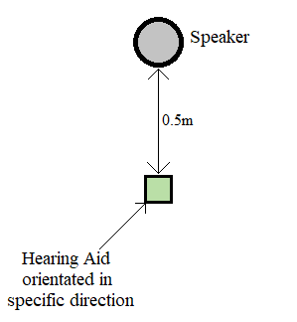
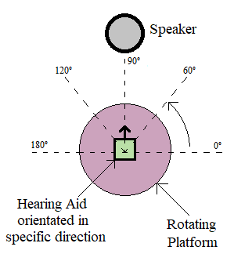
Testing
Compensatory gain
Directionality

Slide 10
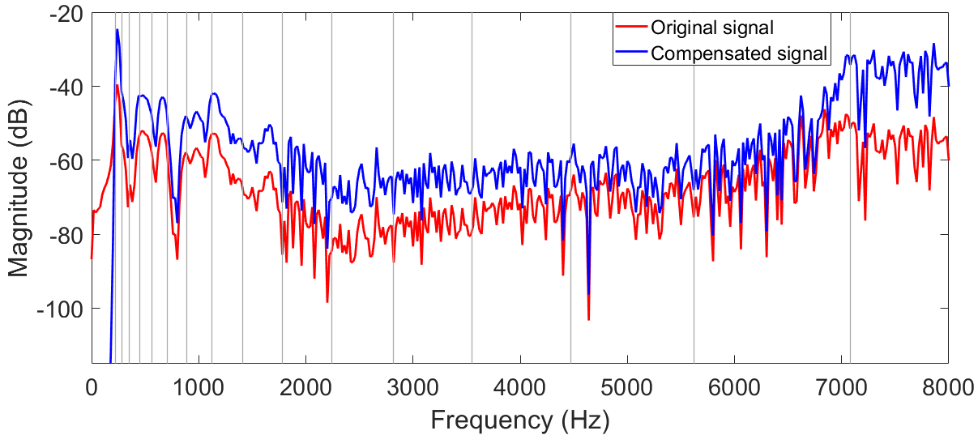
Results: Simulation

Slide 11
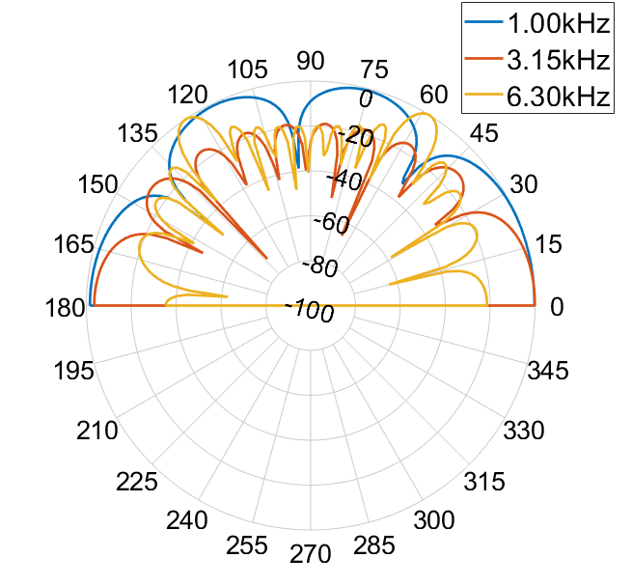
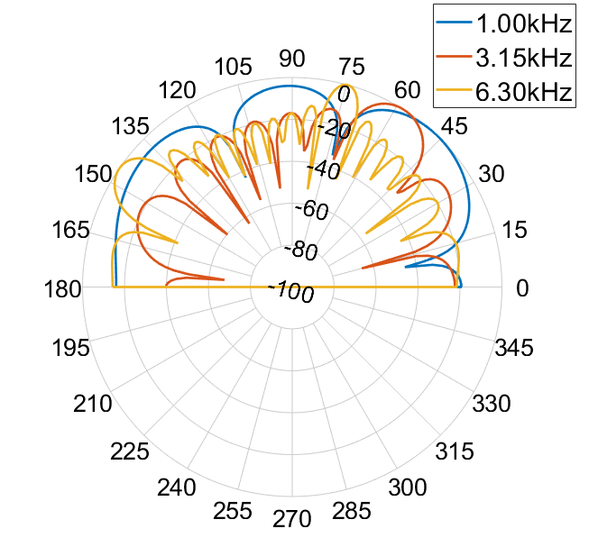
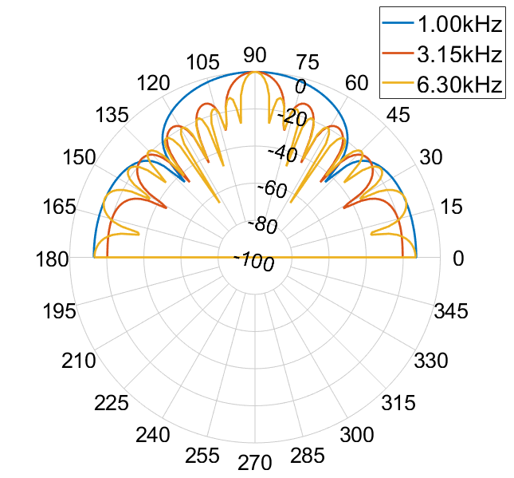
Results: Simulation
0°
60°
90°

Slide 12
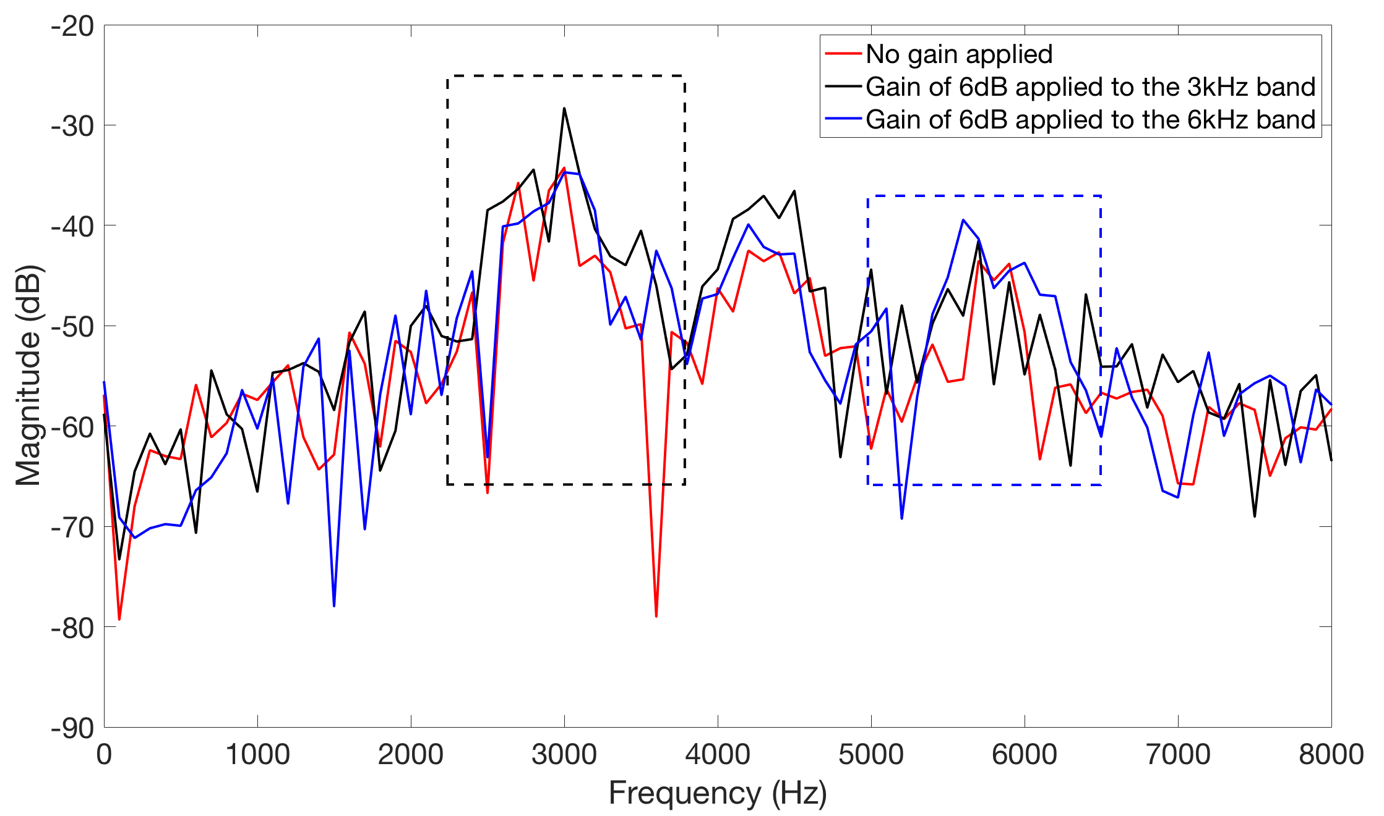
Results: Hardware

Slide 13
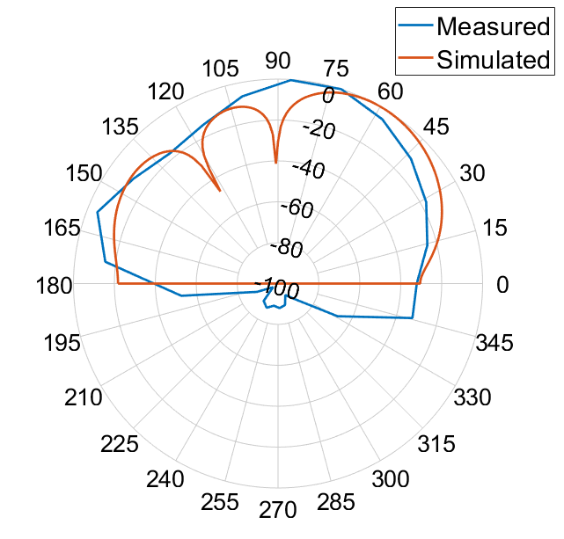
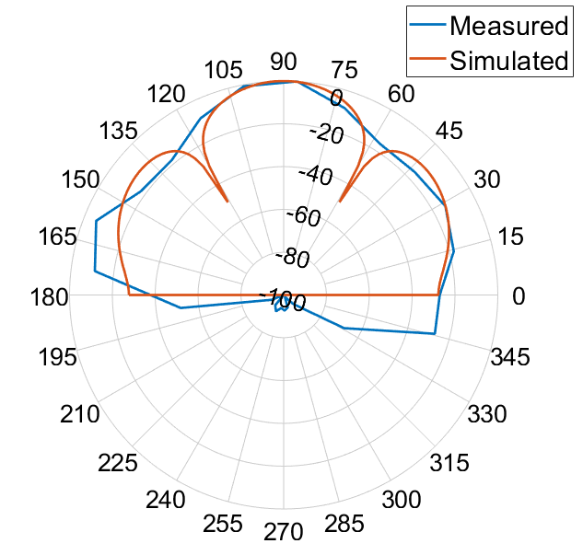
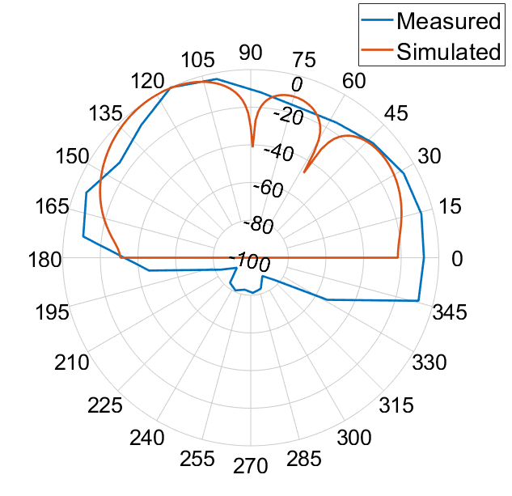
Results: Hardware
60°
90°
120°

Slide 14
Future Work
Higher quality omni-directional microphones
More microphones
Improve the precision of the beam steering
Integrated circuit chip
Preprocessing of the audio signals
Emdedding the microphones and circuitry into headphones
Reduce the size of the device
Make the device more user friendly

Slide 15
Conclusion

